Slide 1
Mutation Testing

Slide 2
Mutation Testing
Mutation testing is a fault-based testing technique.
It has been empirically and theoretically validated that a program will be well tested if most simple faults are detected and removed.

Slide 3
Mutants
Mutation testing generates a set of faulty versions of the original program.
Each version, called a mutant, contains a single fault.
A fault is introduced into the original program by a single syntactic change to a program statement.

Slide 4
An Example
1 int max(int x, int y)
2 {
3 int mx = x;
4 if (x > y)
5 mx = x;
6 else
7 mx = y;
8 return mx;
9 }
1 int max(int x, int y)
2 {
3 int mx = x;
4 if (x < y)
5 mx = x;
6 else
7 mx = y;
8 return mx;
9 }
>=
<=
==
!=

Slide 5
Mutation Analysis Process
A set of test cases are first applied to the original program to detect and fix the faults in the program.
Test cases are then applied to the mutants.
A mutant is killed by a test case if it generates a different output from the original program.
A test case is adequate if it kills at least one mutant.

Slide 6
Equivalent Mutants
Two programs are functionally equivalent if they always produce the same output on every input.
If a mutant is functionally equivalent to the original program, then it cannot be killed by the set of test cases.

Slide 7
Mutation Score
A mutation score of a set of test cases is the percentage of non-equivalent mutants that are killed by the set of test cases.
If a program P has M mutants, E of which are equivalent, and a set of test cases T kills K mutants, then the mutation score is defined as
K
MS(P, T) = .
M - E

Slide 8
Measuring Adequacy of Test Cases
Mutation analysis is a way to measure the adequacy of a set of test cases.
A set of test cases is mutation adequate if its mutation score is 100%.
In practice, it is difficult to have a set of test cases that has mutation score above 95%.

Slide 9
Mutation Operators
A mutation operator is a syntactic change to a program to create mutant.
The set of mutation operators depends on the programming language.
Mothra is a mutation testing system for Fortran 77 that supports 22 mutation operators.

Slide 10
Mutation Operators in Mothra
AAR: array reference for array reference replacement
ABS: absolute value insertion
ACR: array reference for constant replacement
AOR: arithmetic operator replacement
ASR: array reference for scalar variable replacement

Slide 11
Mutation Operators in Mothra
CAR: constant for array reference replacement
CNR: comparable array name replacement
CRP: constant replacement
CSR constant for scalar variable replacement
DER: DO statement end replacement
DSA: DATA statement alternations
GLR: GOTO label replacement

Slide 12
Mutation Operators in Mothra
LCR: logical connector replacement
ROR: relational operator replacement
RSR: RETURN statement replacement
SAN: statement analysis
SAR: scalar variable for array reference replacement
SCR: scalar for constant replacement
SDL: statement deletion

Slide 13
Mutation Operators in Mothra
SRC: source constant replacement
SVR: scalar variable replacement
UOI: unary operator insertion

Slide 14
High Cost of Mutation Testing
The main drawback of mutation testing is the high cost of running vast number of mutants against the set of test cases.
The number of mutants generated for a program is proportional to the product of the number of data references and the number of data objects.
This number is large for even small programs.

Slide 15
Reducing Cost of Mutation Testing
Selective mutation: a “do fewer approach”.
Weak mutation: a “do smarter approach”.
Schema-based mutation analysis: a “do faster approach”.
MuJava is a mutation testing system for Java that implements these three approaches.
http://ise.gmu.edu/~ofut/mujava/
MuClipse is an Eclipse plugin for MuJava.
http://muclipse.sourceforge.net/

Slide 16
Selective Mutation
Selective mutations are mutations that omit the operators that create the most mutants.
A N-selective mutation omits the N most prevalent operators.
For example, a 2-selective mutation for Mothra will omit the SVR and ASR operators.

Slide 17
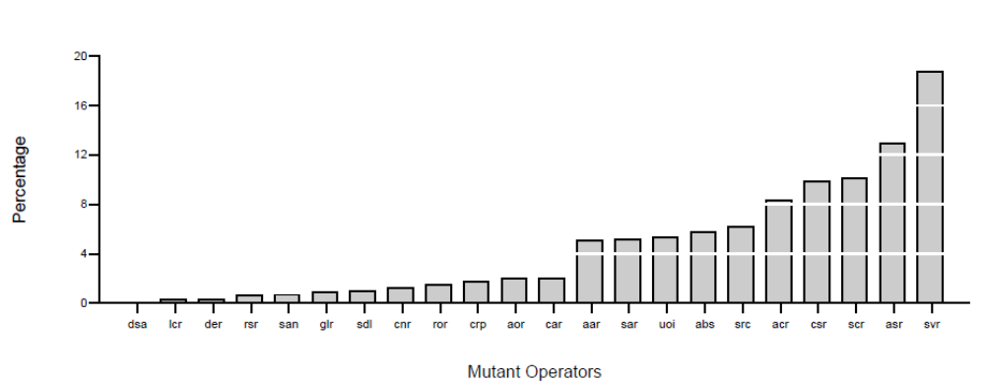
Distribution of Mutation Operators

Slide 18
Categories of Mutation Operators
Replacement of Operand operators: replace each operand in a program with each other legal operand. (AAR, ACR, ASR, CAR, CNR, CRP, CSR, SAR, SCR, SRC, and SVR)
Expression Modification operators: modify expressions by replacing operators or inserting new operators. (ABS, AOR, LCR, ROR, and UOI)
Statement Modification operators: modify entire statements. (DER, DSA, GLR, RSR, SAN, and SDL)

Slide 19
Coverage and Saving
Mutation Score Percentage Saved
ES 99.54 71.52
RS 97.31 22.44
RE 99.97 6.04
E 99.51 77.56

Slide 20
Summary
Experiments show that 5 key mutation operators ABS, AOR, LCR, ROR, and UOI provide almost the same coverage as the 22 mutation operators in Mothra.
The cost reductions are at least 4 times for small programs and up to 50 times for large programs.

Slide 21
Method Level Mutation Operators in MuClipse
AOR: Arithmetic operator replacement (+, -, *, /, %, +, -, ++, --)
AOI: Arithmetic operator insertion (+, -, ++, --)
AOD: Arithmetic operator deletion (+, -, ++, --)
ROR: Relational operator replacement (>, >=, <, <=, ==, !=)

Slide 22
Method Level Mutation Operators in MuClipse
COR: Conditional operator replacement (&&, ||, !)
COI: Conditional operator insertion (!)
COD: Conditional operator deletion (!)
SOR: Shift operator replacement (<<, >>, >>>)

Slide 23
Method Level Mutation Operators in MuClipse
LOR: Logical operator replacement (&, |, ^)
LOI: Logical operator insertion (~)
LOD: Logical operator deletion (~)
ASR: Assignment operator replacement (+=, -=, *=, /=, %=, &=, |=, ^=, <<=, >>=, >>>=)

Slide 24
Weak Mutation
Weak mutation is an approximation technique that compares the internal states of the mutant and the original program immediately after the execution of the mutated portion of the program.
Experiments show that weak mutation is almost as effective as strong mutation.
The cost reductions are at least 50%.

Slide 25
Four Potential Points for State Comparisons
After the first evaluation of the innermost expression surrounding the mutated symbol.
After the first evaluation of the mutated statement.
After the first evaluation of the basic block that contains the mutated statement.
After each evaluation of the basic block that contains the mutated statement.
best

Slide 26
Schema-Based Mutation Analysis
The schema-based mutation analysis encodes all mutants into a specially parameterized source-level program, called a metamutant.
The metamutant is compiled using the same compiler used to compile the original program.
The metamutant has the ability to function as any of the mutant at runtime.
Cost reductions can be an order of magnitude.

Slide 27
Metaoperators
Consider the AOR mutation operator.
For the statement, Result = A – B, four mutants are yielded:
Result = A + B
Result = A * B
Result = A / B
Result = A % B
These four mutants can be generically represented as Result = A ArithOp B, where ArithOp is a metaoperator.

Slide 28
Metaprocedures
The generic representation can be rewritten as Result = AOrr(A, B), where AOrr function performs one of the five possible arithmetic operations.
AOrr is an example of a metaprocedure.

Slide 29
Class Level Mutation Operators in MuClipse
Access control: AMC
Inheritance: IHD, IHI, IOD, IOP, IOR, ISK, IPC
Polymorphism: PNC, PMD, PPD, PRV
Overloading: OMR, OMD, OAO, OAN
Java-specific features: JTD, JSC, JID, JDC
Common-programming mistakes: EOA, EOC, EAM, EMM

